Slide 1
2 Stage Miller Compensated OTA
Design and Analysis of a 2-Stage OTA in 180 nm TSMC Technology using LTspice
Mentees
Sai Easwar, Aarav Balaji, Vishva, Pratham, Suhail
Mentors
Garvit, Kaustubh, Rakesh ,Mohnish
NITK Surathkal | 2026

Slide 2
Goal
To design a two-stage Miller compensated OTA in 180 nm CMOS technology and compare its performance with single-stage and uncompensated two-stage OTAs to demonstrate the improvement in gain and stability.
Key Challenges Solved
Achieving high voltage gain: High gain often requires multiple amplification stages, which increases circuit complexity.
Introduction of multiple high-frequency poles: Additional gain stages create extra poles in the frequency response that can interact with each other.
Reduced stability and phase margin: Improper pole placement can lead to poor phase margin, causing instability or oscillations.
Ensuring a stable frequency response: Proper compensation is required to control pole locations and maintain stability while preserving bandwidth.

Slide 3
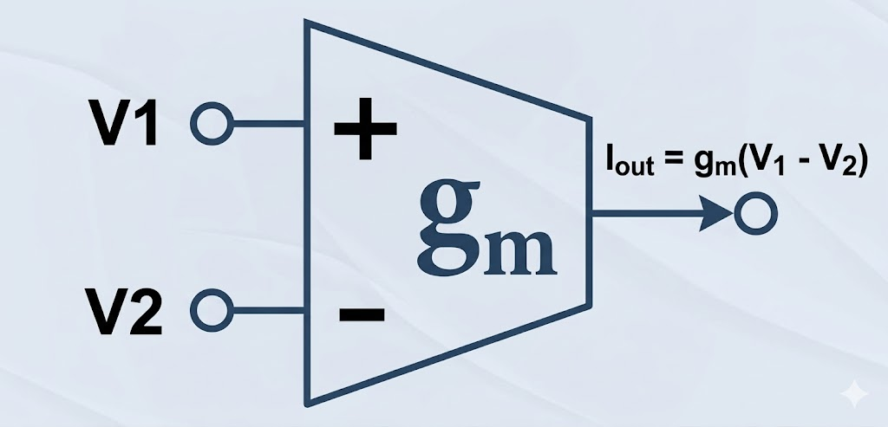
Introduction
An Operational Transconductance Amplifier (OTA) is a fundamental analog building block that converts an input differential voltage into an output current. OTAs are widely used in analog integrated circuits such as filters, data converters, comparators, and analog signal processing systems.

Slide 4
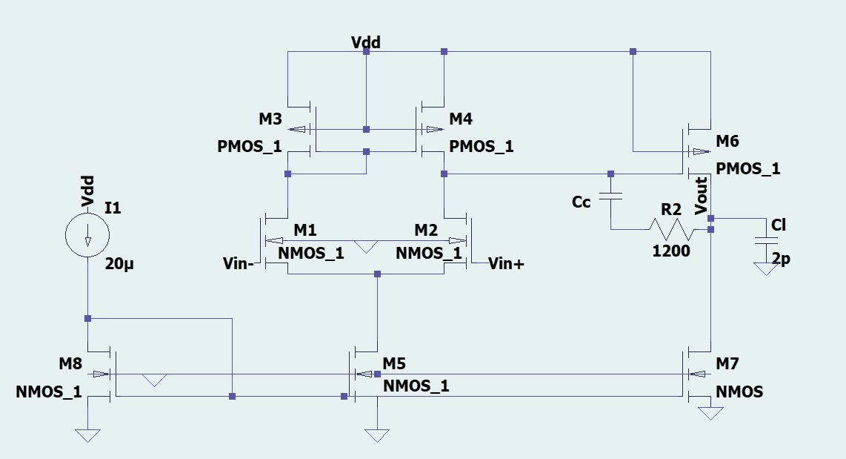
Circuit Theory and Architecture
A Two-Stage Operational Transconductance Amplifier (OTA) consists of two cascaded gain stages to achieve high voltage gain.

Slide 5
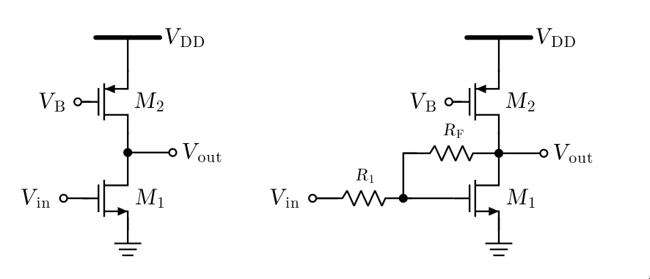
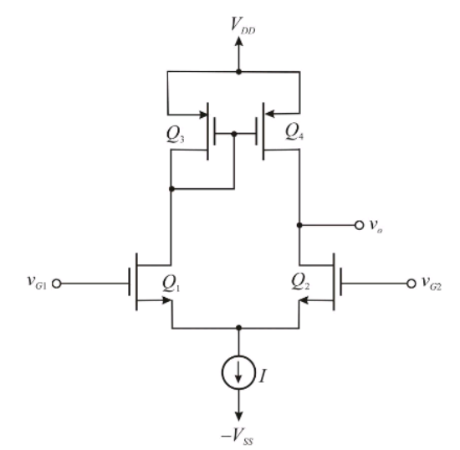
The first stage is typically a differential amplifier that converts the input differential voltage into current and provides initial gain and high input impedance.
The second stage is a common source amplifier that provides additional gain and large output voltage swing to drive the load.

Slide 6
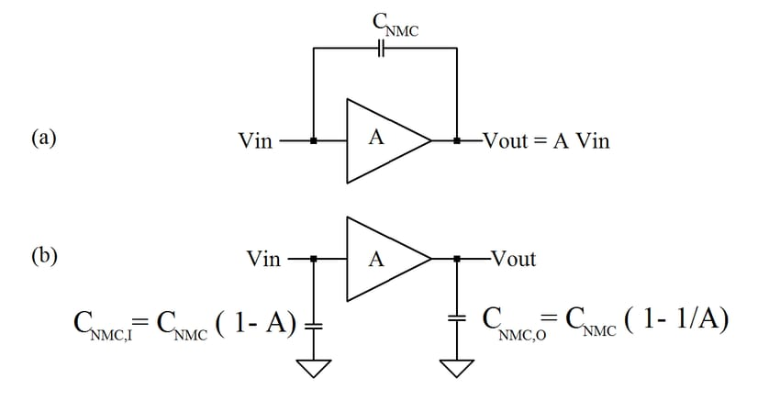
Since multiple gain stages introduce multiple poles, the amplifier can become unstable.
To improve stability, we add a compensation capacitor between the stages, creating a dominant pole and improving phase margin
Because the capacitance value is effectively increased due to the Miller effect, the compensation technique is referred to as Miller Compensation.
Miller’s Theorem

Slide 7

OTA Design Specifications
Parameter | Target Value
Process Technology | 0.18µm CMOS
Supply Voltage (VDD) | 1.8V
DC Open-Loop Gain (Av) | ≥60dB
Gain Bandwidth Product (GBW) | 30MHz
Phase Margin (Φm) | ≥60°
Slew Rate (SR) | 20V/µs
Load Capacitance (Cload) | 2pF
Maximum Input Common Mode Range(ICMRmax) | 1.6V
Minimum Input Common Mode Range(ICMRmin) | 0.8V

Slide 8
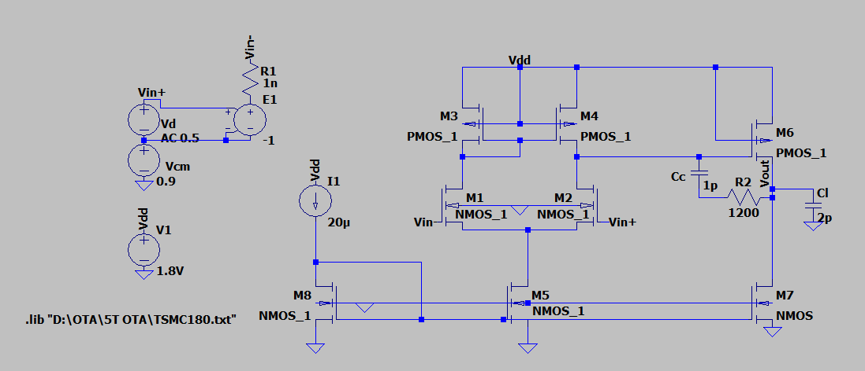
Final Circuit

Slide 9
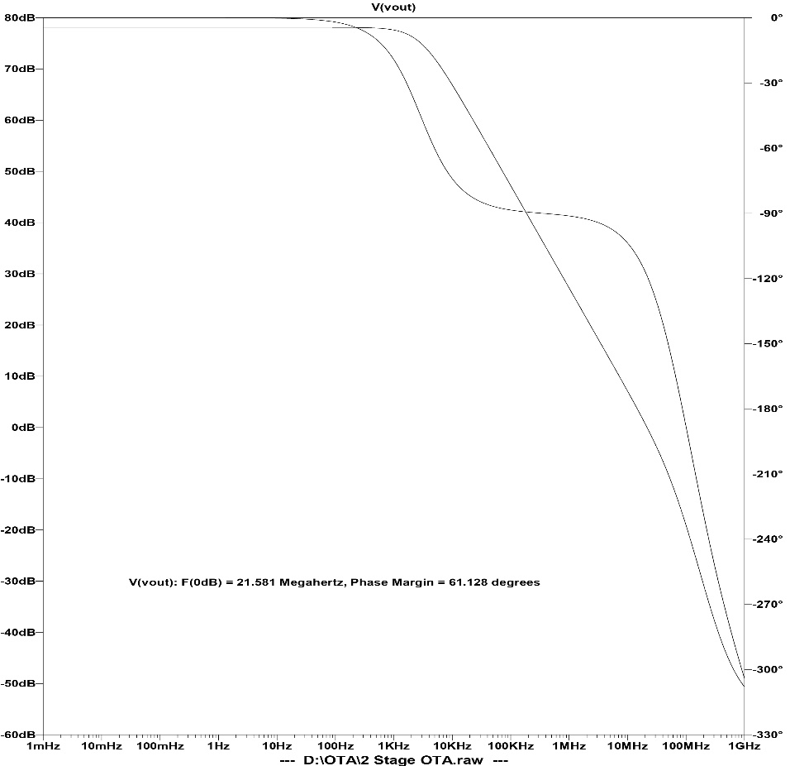
Simulation Results
Parameters | Value
Differential Gain | 77dB
Common Mode Gain | 2.6dB
Phase Margin (Φm) | 61.128°
Gain Bandwidth Product (GBW) | 21.5MHz
3dB Cutoff Frequency | 3.135kHz
CMRR | 74.4dB
Poles | 1KHz,8.8MHz

Slide 10
Design Progression of the OTA
2 Stage without compensation
2 Stage with compensation
Single Stage
DC gain ≈ 39.5dB
Pole ≈ 135KHz
UGF = 12.329MHz
PM = 87.224°
DC gain ≈ 78dB
Poles ≈ 10KHz,3MHz
UGF =54MHz
PM = = -21 °
DC gain ≈ 78dB
Poles ≈ 1KHz,8.8MHz
UGF = 21.581MHz
PM = 61.128°
The addition of the second stage increases the overall gain of the OTA.
However, the presence of multiple poles makes the amplifier unstable.
Therefore, a compensation capacitor is introduced to stabilize the system while maintaining high gain
Furthermore, it is observed that the dominant pole shifts to a lower frequency while the non-dominant pole moves to a higher frequency due to pole splitting, which further improves the stability of the amplifier.

Slide 11
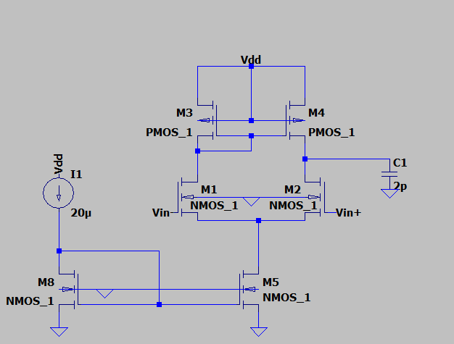
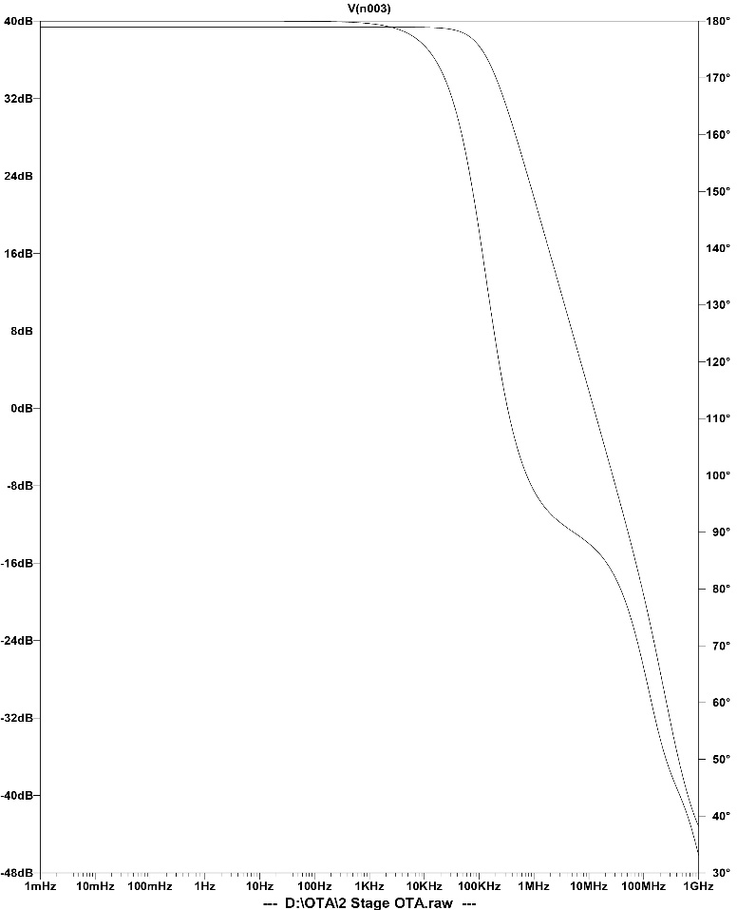
Single Stage OTA
DC gain ≈ 39.5dB
Pole ≈ 135KHz
UGF = 12.329MHz
PM = 87.224°

Slide 12
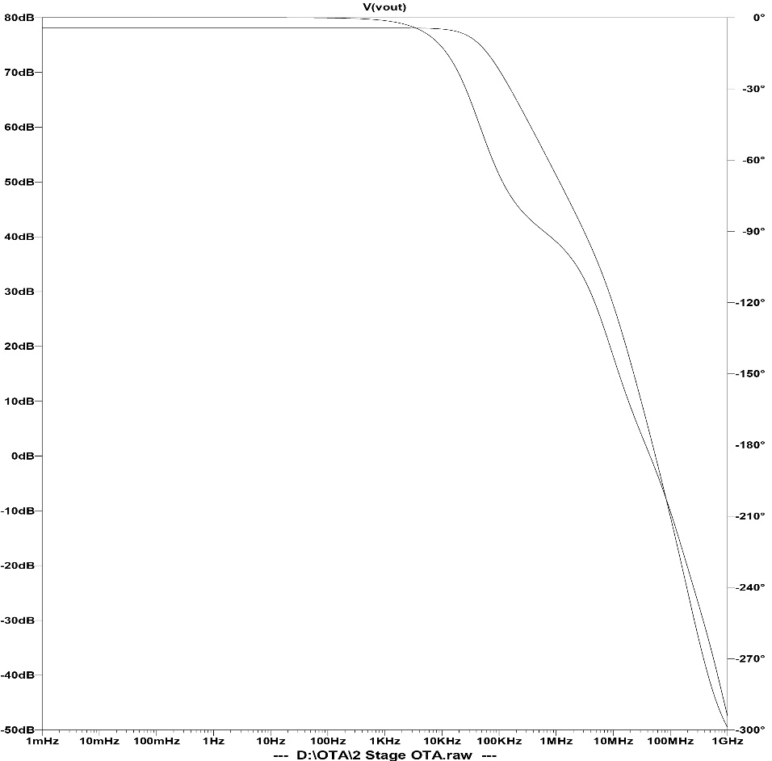
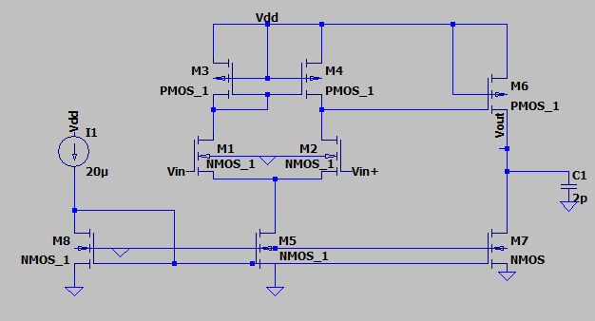
2 Stage OTA without compensation
DC gain ≈ 78dB
Poles ≈ 10KHz,3MHz
UGF =54MHz
PM= -21 °

Slide 13
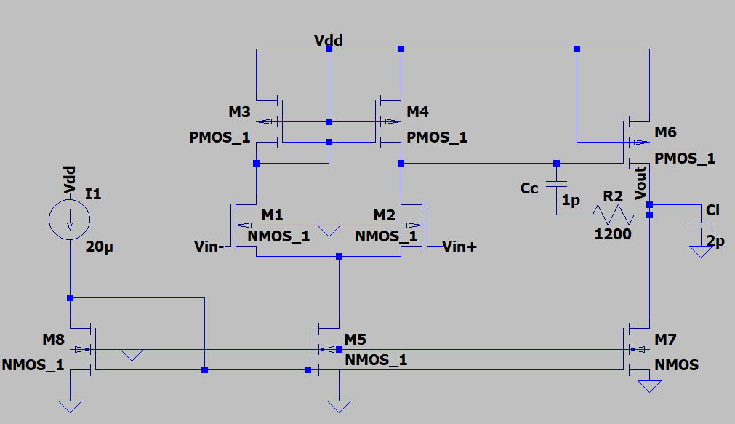
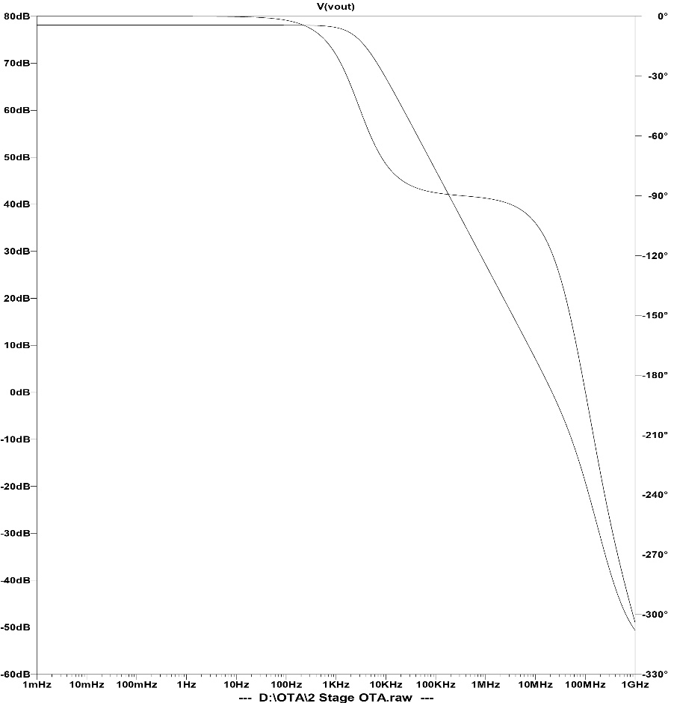
2 Stage OTA With compensation
DC gain ≈ 78dB
Poles ≈ 1KHz,8.8MHz
UGF = 21.581
PM = 61.128°

Slide 14
Future Scope
Gain Enhancement using Cascoding The voltage gain of the OTA can be further increased by incorporating cascode structures, which increase the output resistance of the amplifier.
Fully Differential Design The OTA can be extended to a fully differential architecture for improved performance.
Power Optimization Power consumption can be reduced by optimizing bias currents and transistor sizing.
Alternative Compensation Techniques Other compensation methods such as feedforward compensation, or nested Miller compensation can be explored to further improve the stability and bandwidth of the OTA.

Slide 15
Thank You :)

